Slide 1


The Power of Listening -2

Slide 2
Listening Overview
Section | Content | Time | Mode | Score
Listening | lectures Conversations ( Audio) | 5 minutes 3 minutes | Multiple Choice | 02
 | Video Talks | 15 minutes | Paragraph | 03

Slide 3
Audio- Types of Listening Passages
Lectures
professor speaks on a given topic
Classroom discussions
professor and students discuss an academic topic
Conversations
office hours with a student visit to a professor
service encounters with support staff
Taking notes is allowed and encouraged.

Slide 4
Question Sets
Each set
two lectures and one conversation
each set of passages has 10 questions
Time
15 minutes to listen
10 minutes to answer
Lecture questions are more difficult than conversation questions.
Question order usually follows order of information in passage.

Slide 5
Question Types
Multiple Choice Questions
Most have four choices and one correct answer
Gist: purpose for a conversation
Inference: draw conclusion from stated facts
Detail: main supporting details
may have two or three correct answers
if two correct answers, then four answer choices; if three correct answers, then five answer choices.
Connecting Content Questions – Place Checkmarks in the correct boxes
Attitude/ Tone : Exhibit the analytical skills -meaning behind
speaker’s words

Slide 6
Gist Questions
As each listening passage starts, the narrator will inform you of the main topic of the academic talk or dialogue so you have a slight idea of what to expect.
No matter what the topic is, you should be able to understand what the main idea of the passage is.
Almost all of the prompts will include the word "mainly" in it so this type is easy to identify.

Slide 7
Gist Questions
Question: What is the main topic of discussion?
A. Chronological history of Victorian chemistry
B. The varied attempts at element classification
C. Mendeleev's life and ultimate achievements
D. Publication of chemistry works in the 1800's

Slide 8
Detail Questions
The detail type of listening question asks you to identify factual information that is stated directly in the passage.
Sample prompts for this kind of question:
According to the professor, what is DETAIL?
What is one way that DETAIL can affect _______ ?
According to the professor, how does DETAIL do ___

Slide 9
Example – Detailed Question |  | People who are allergic to cat will have following symptoms
(woman) | Many people are allergic to cats. If they come in contact with cats, they sneeze, their skin turns red, and their eyes begin to burn. However, it is not only people who suffer from allergies. Cats may also be allergic to pollen, dust, and perfumes, many of the same agents that cause allergies in people. Perhaps your cat is sneezing and has watery eyes. If you think that your cat has some allergies, a veterinarian can prescribe medication to help solve the problem. | 1. 2. | A. sneeze B. Eyes turn red C. Eyes begin to burn D. Will have watery eyes

Slide 10
Inference Question
you should be able to decide what logically might happen next, or be able to reason what the speaker means – what is implied – by saying or asking something.
For this type of question, it is the opinions, feelings, thoughts of the speaker you need to be able to understand and not just the factual information.

Slide 11
Inference Question
Example
(woman) Steve, is something the matter? You
don’t look very good. Do you want me to help you?
(man) Oh, I’m feeling a little sick today, it is not serious though.
Question: What does the man mean?
(A) He is seriously ill.
(B) He wants the help
(C) He looks worse than he feels.
(D) He can manage his work.

Slide 12
Connecting Content Questions
This type is a table with options related to the question asked. For each option, you have decide which of 2-3 columns is where it correctly belongs.
This question type can test different kinds of skills:
ability to understand relationships between ideas
ability to organize information differently than the way it was given in the passage
ability to classify items into categories
ability to make comparisons
ability to identify cause and effect

Slide 13
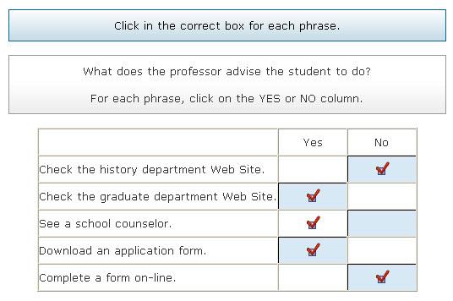
Sample Connected Question

Slide 14
Attitude / Implied Questions
You must be able to understand what lies beneath what the speaker is only suggesting, not directly stating (or asking), about something. You may also be asked if you understand the speaker's attitude or opinion about something.
To do so requires noticing the emotions conveyed by the speaker.
Clues to help you answer this type.
Are they upset or angry or happy or uncertain?
Does the speaker seem to like or dislike something?

Slide 15
Sample Attitude Question
Replayed part of the passage: Narrator: Listen again to part of the conversation. Then answer the question. Student B: Well, I can tell you what she went over. Student A: Oh, OK. Did you take down any notes? What does the student mean when he says this: Student A: Oh, OK. Did you take down any notes? Question: What does the student mean when he says this: [heard again]: Student A: Oh, OK. Did you take down any notes? A. He would like to compare notes. B. He would like to borrow his friend's notes. C. He wants to make sure that his friend's notes are correct. D. He always copies his friend's notes.

Slide 16
Video Talk
How the great leaders inspire…
Merits and limitation of the talk ( 1 paragraph)

Slide 17

Helpful Tips
Audio Talks
Read questions in advance while listening
Categorize questions in to types – factual or opinion
Correct answers are usually restatements of information from the listening passage.
Guess if you’re unsure of an answer
Eliminate the definitely wrong answers.
Choose the answer that is most consistent with the main idea

Slide 18
Video Talk- Helpful Tips
Make notes – main idea – organisation
Draw an outline
Write down points that appeal to you
Write down points where you disagree
You do not lose points for incorrect answer - there is there is no correct answer!
You score points for being logical!

